Slide 1
Web application

Slide 2

IDE
Codenvy
https://codenvy.com

Slide 3
Create Application
Hello world Application.

Slide 4
Create Application
Akatter Application.

Slide 5
Create Application
Design
Entity-relationship Diagram
Screen Configuration Diagram
Screen Transition Diagram

Slide 6
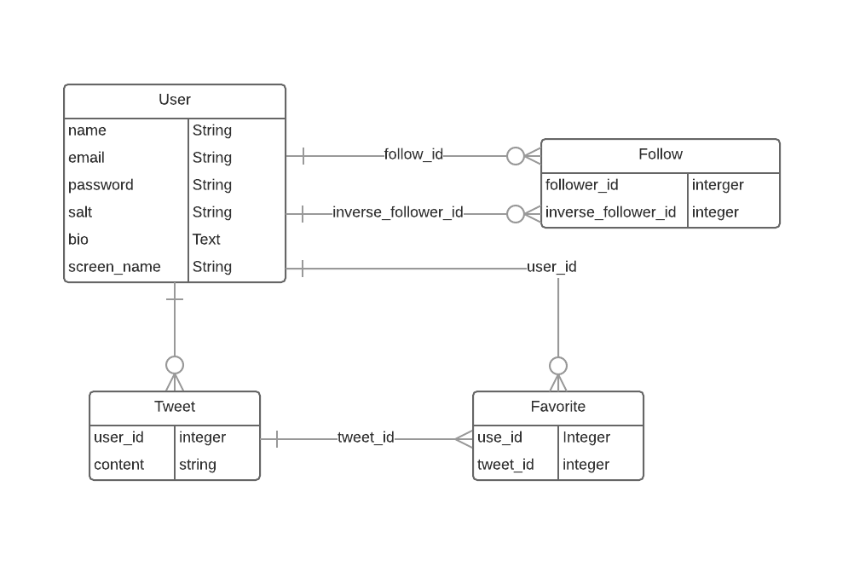
Entity-relationship Diagram

Slide 7
Screen Configuration Diagram

Slide 8
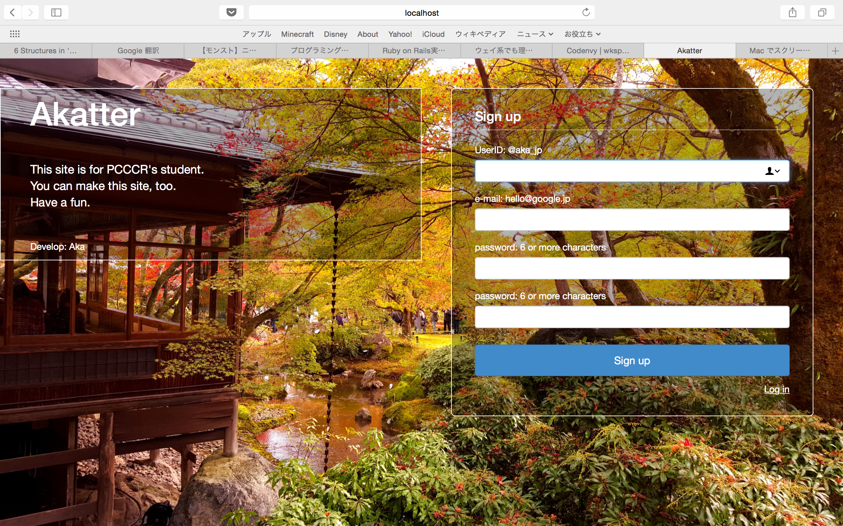
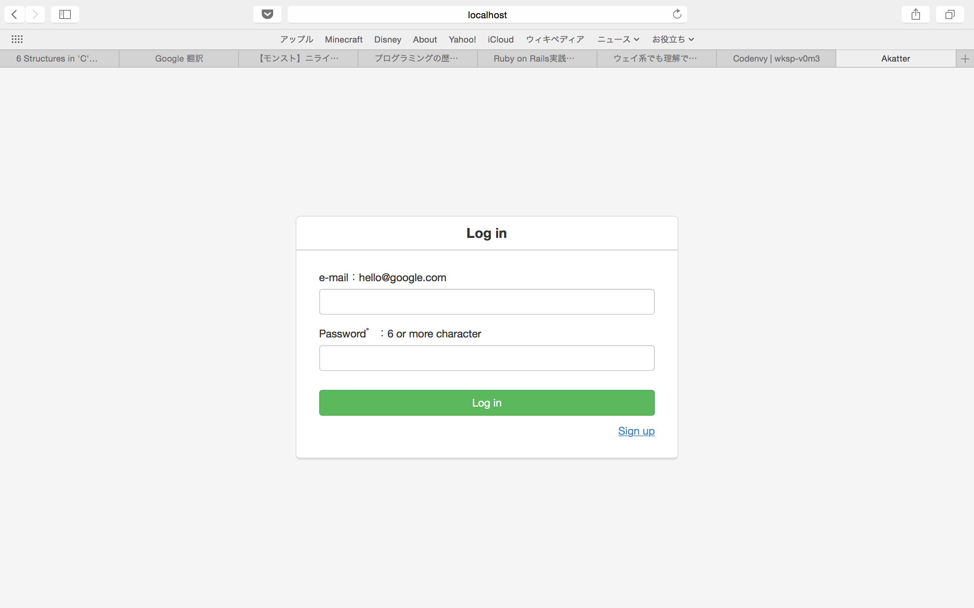
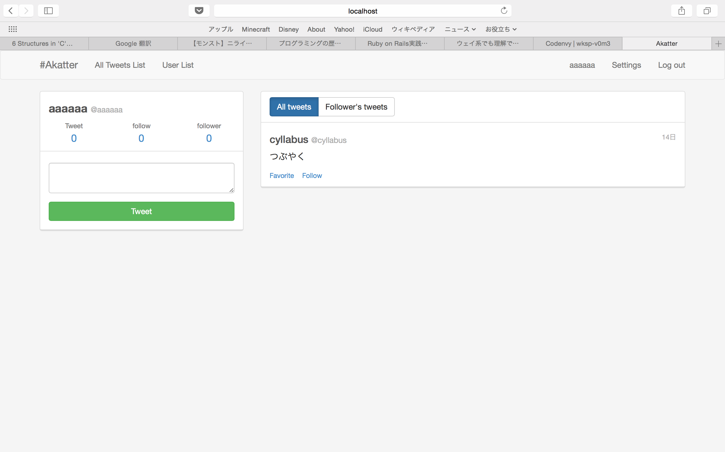
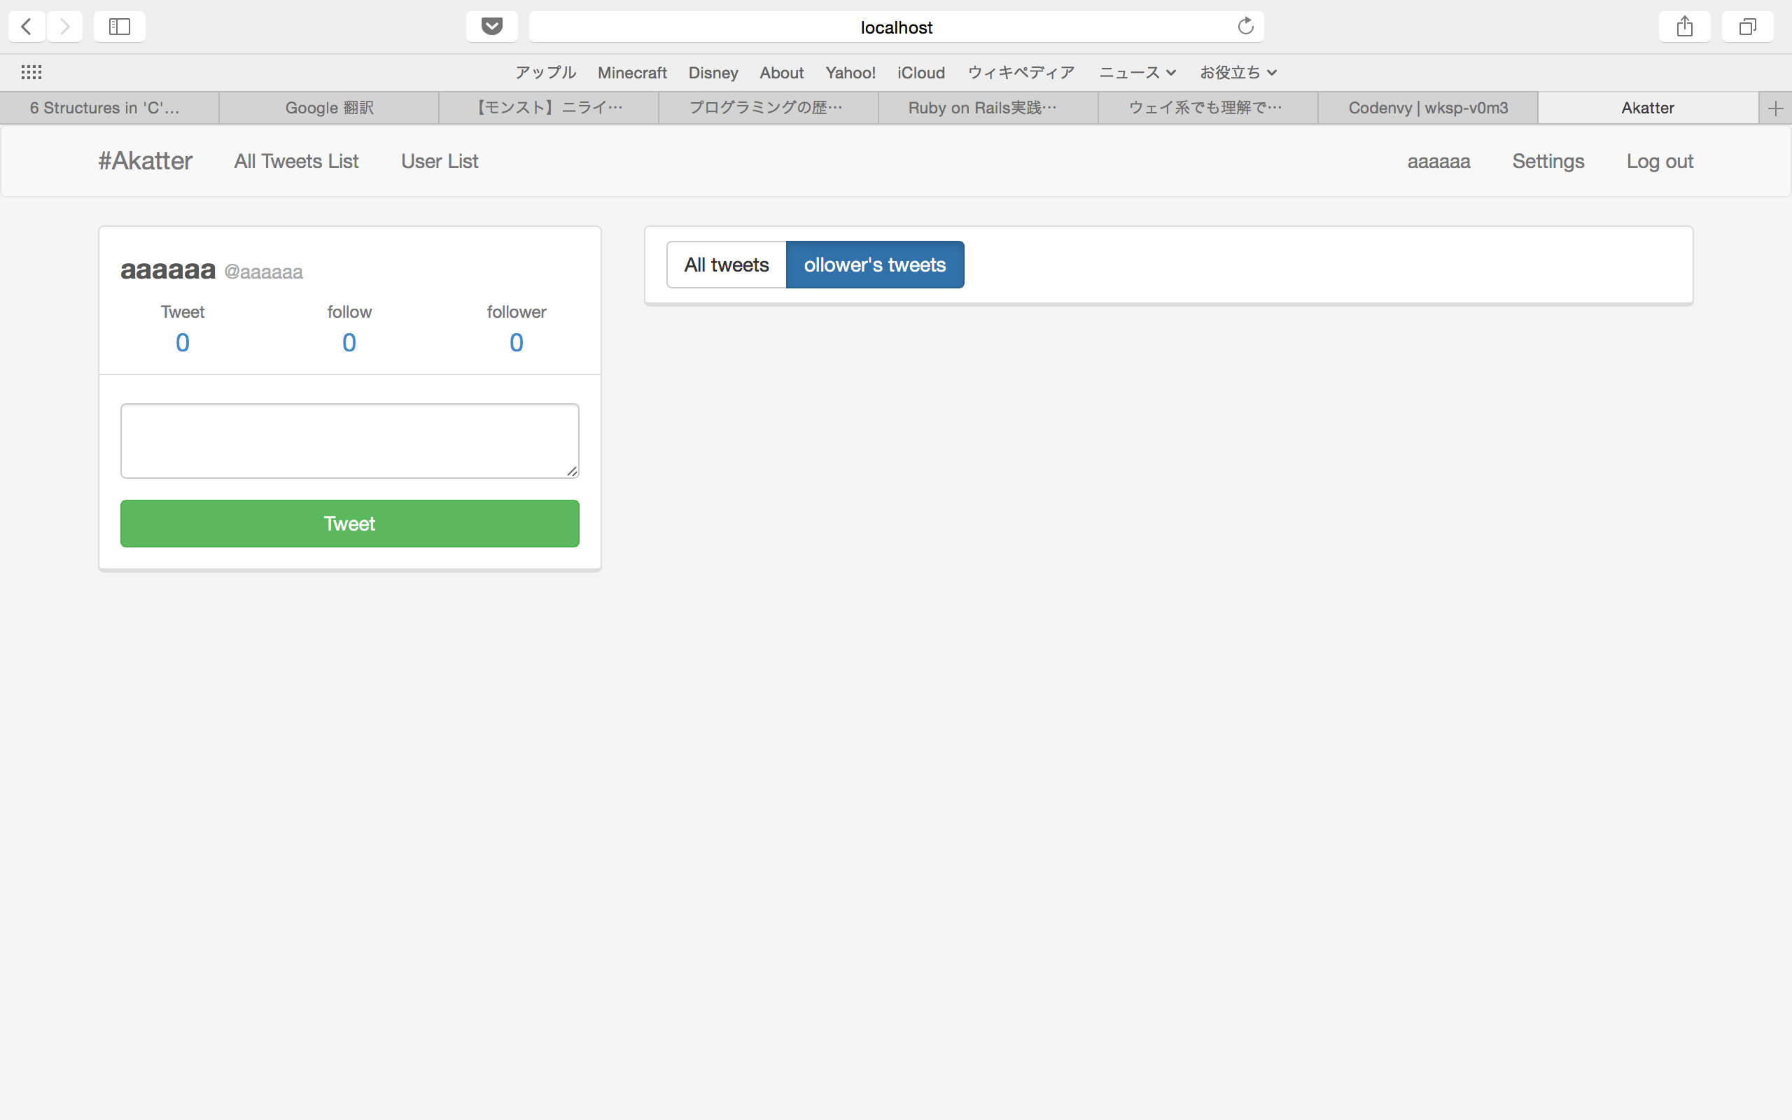
Teaser & Sing Up
Login
Tweet List(All User)
Tweet List(Follower)

Slide 9
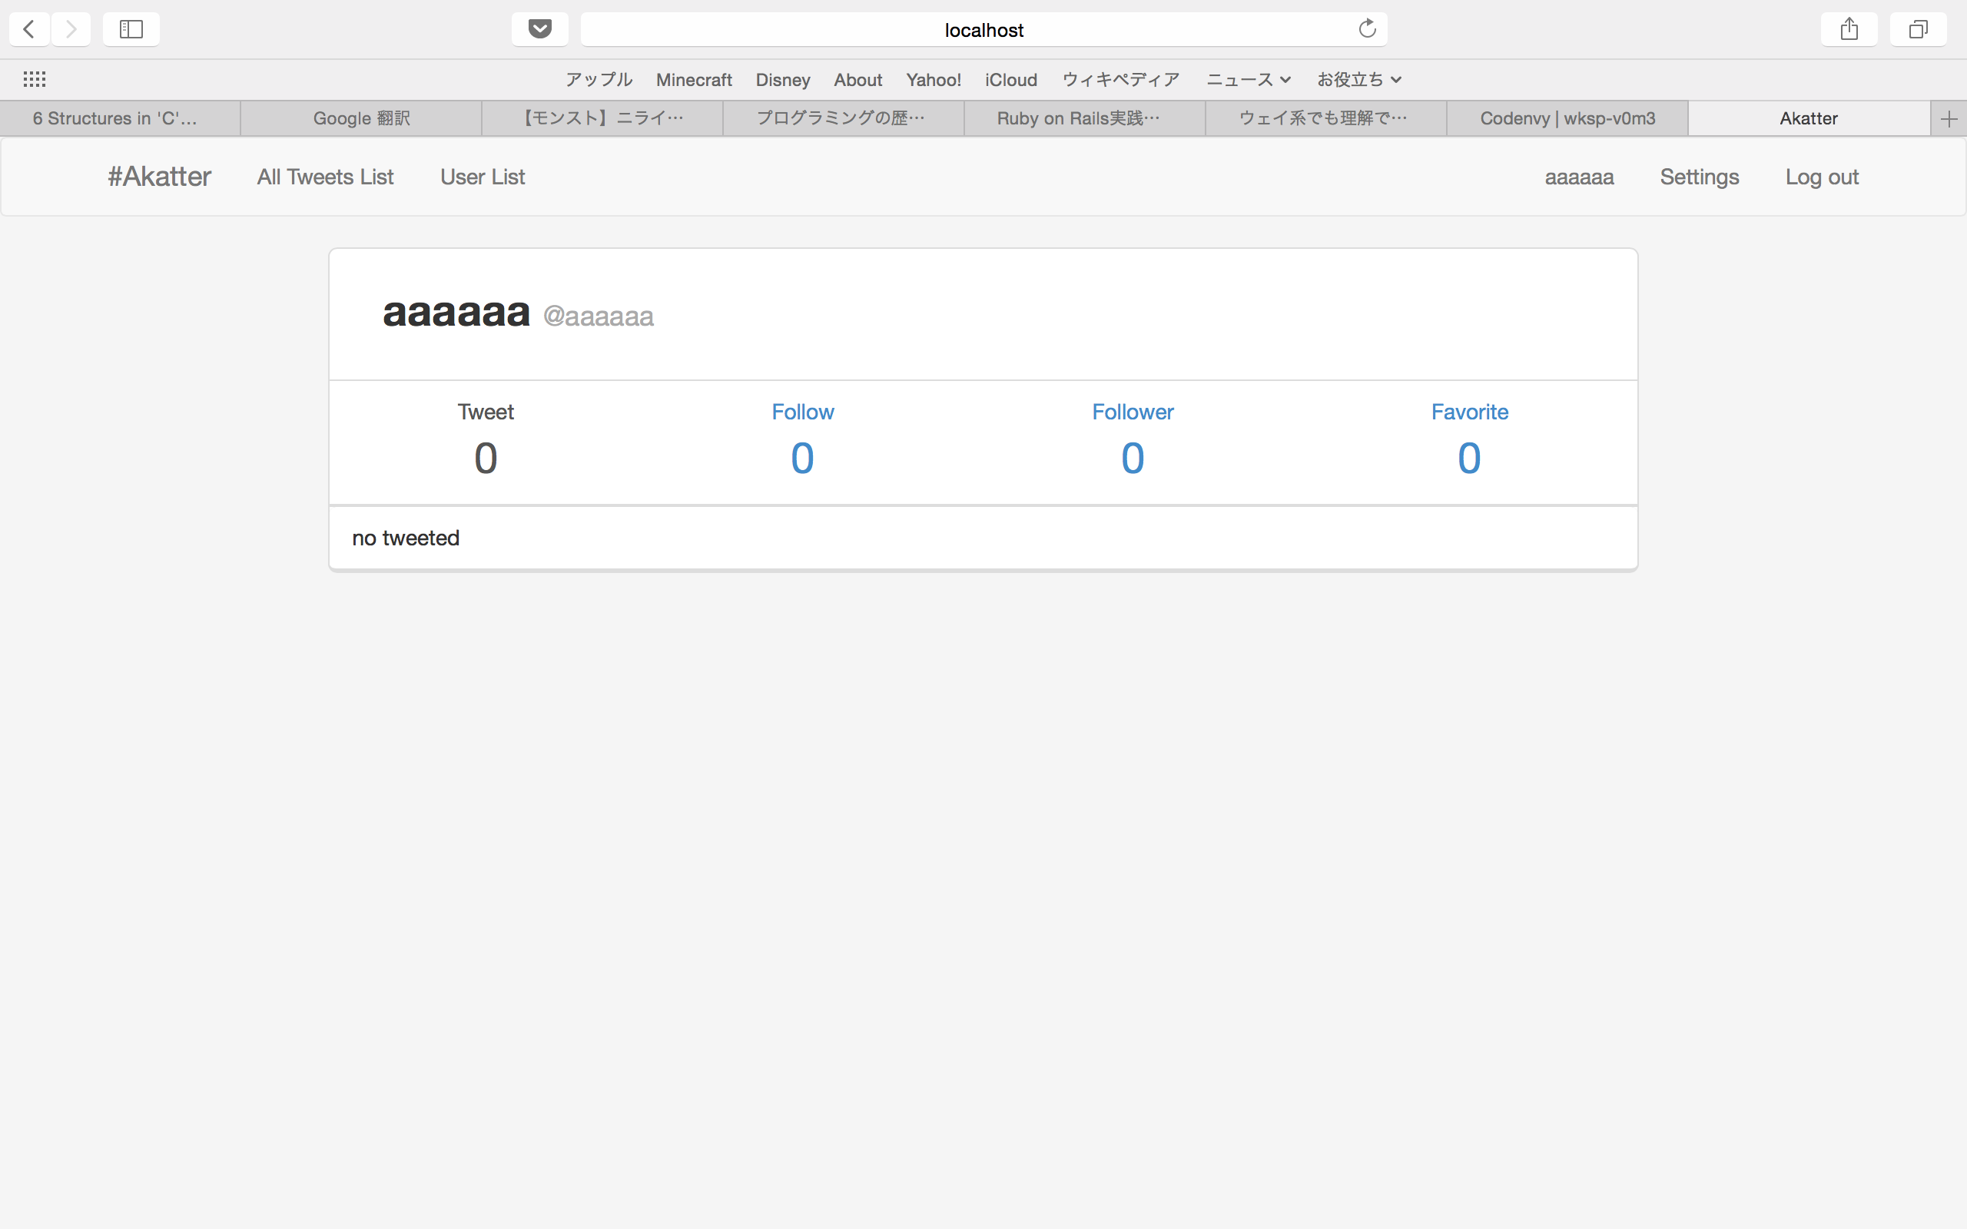
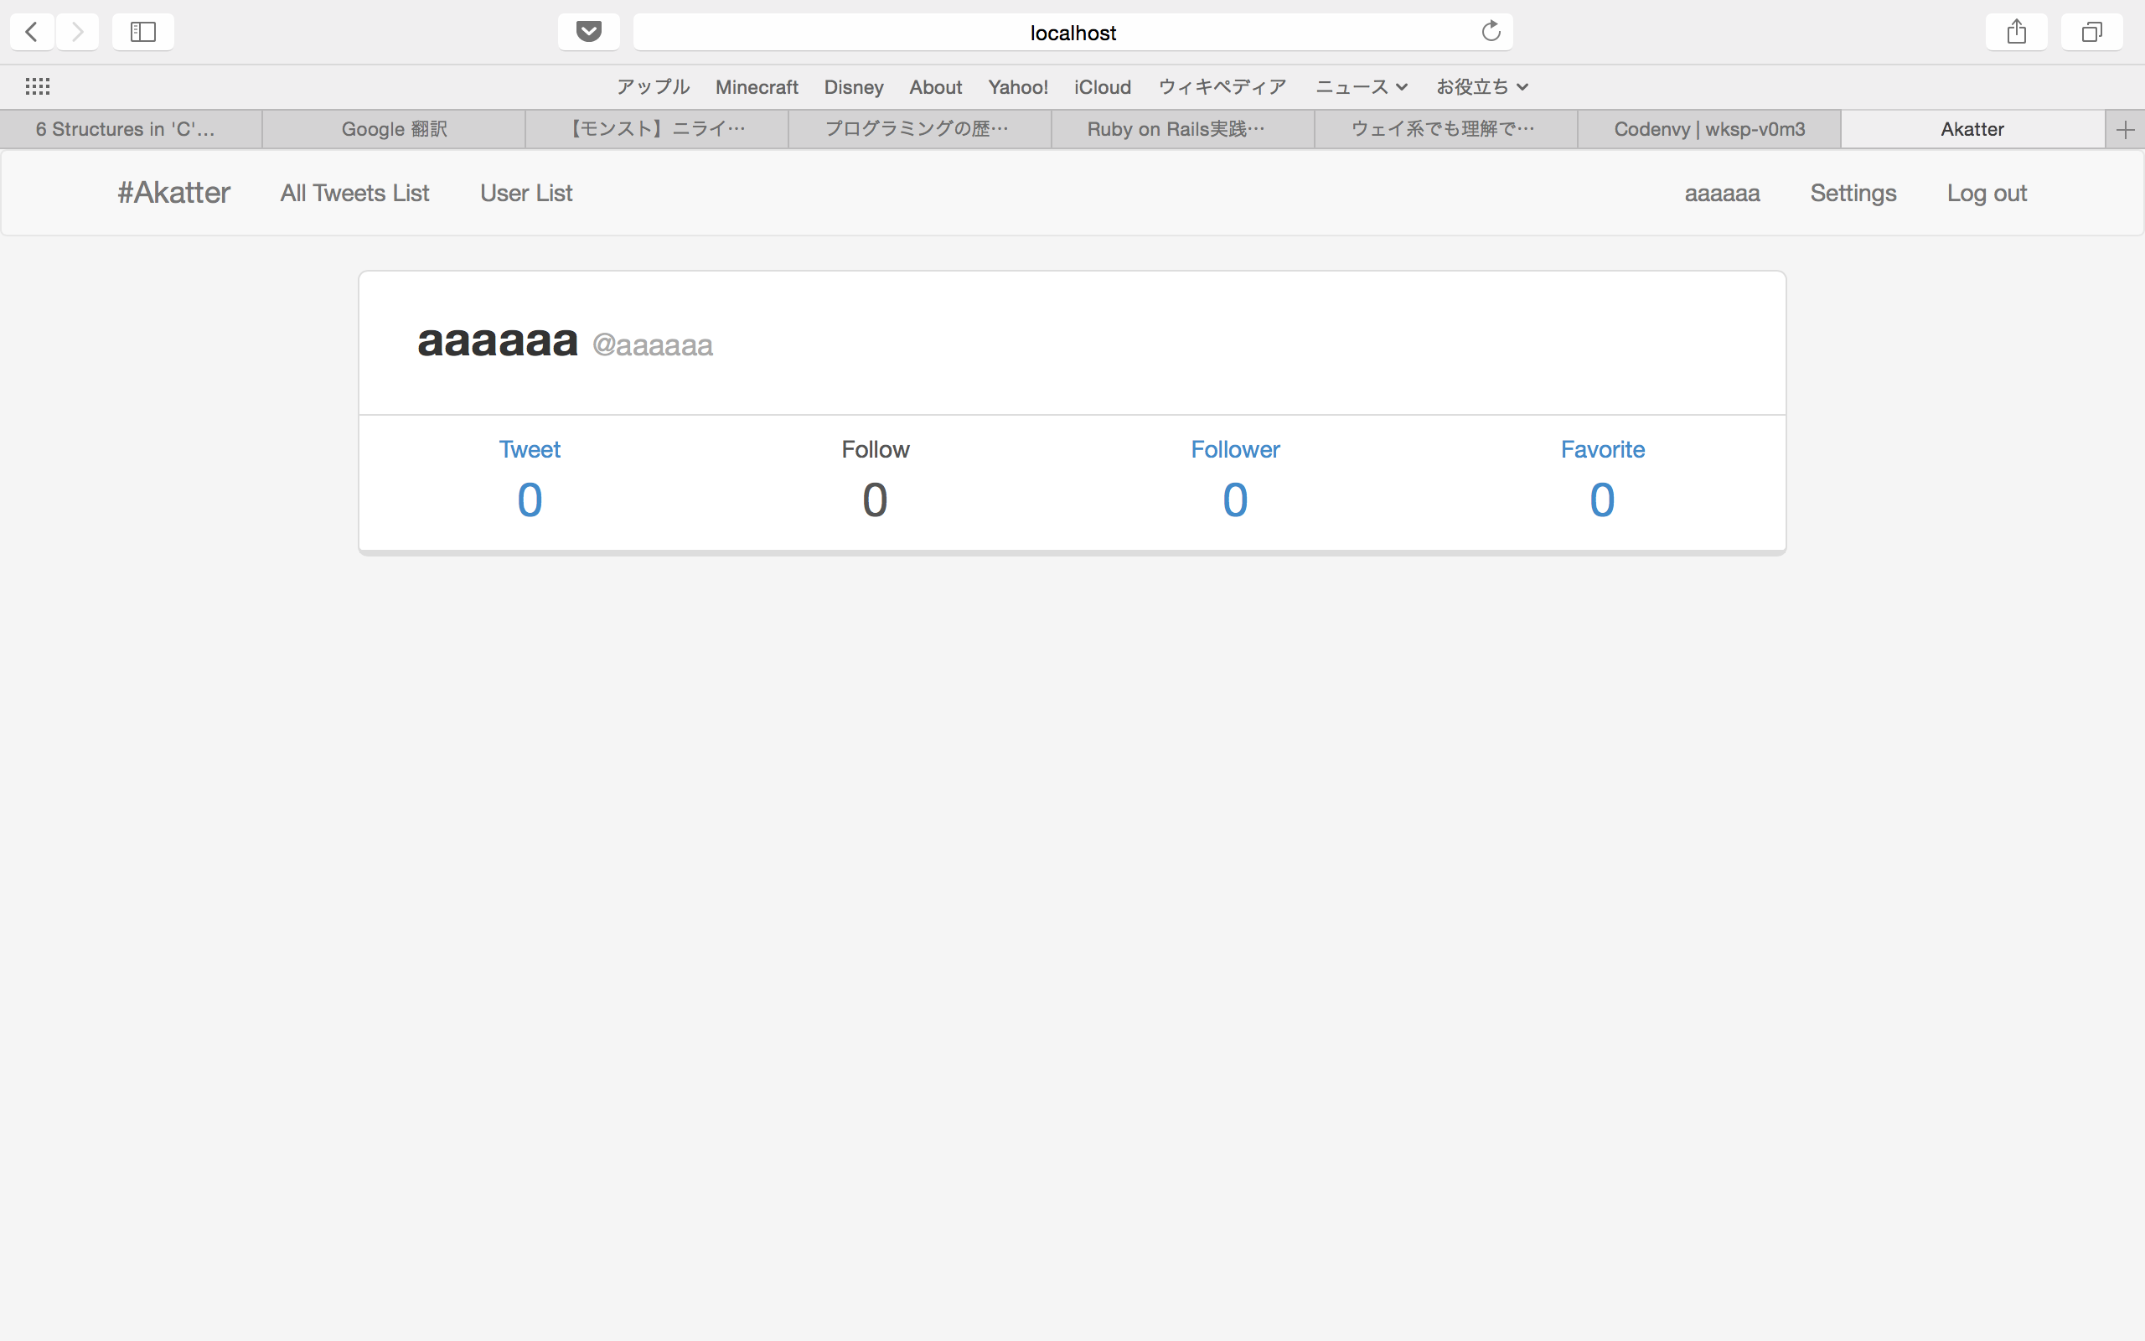
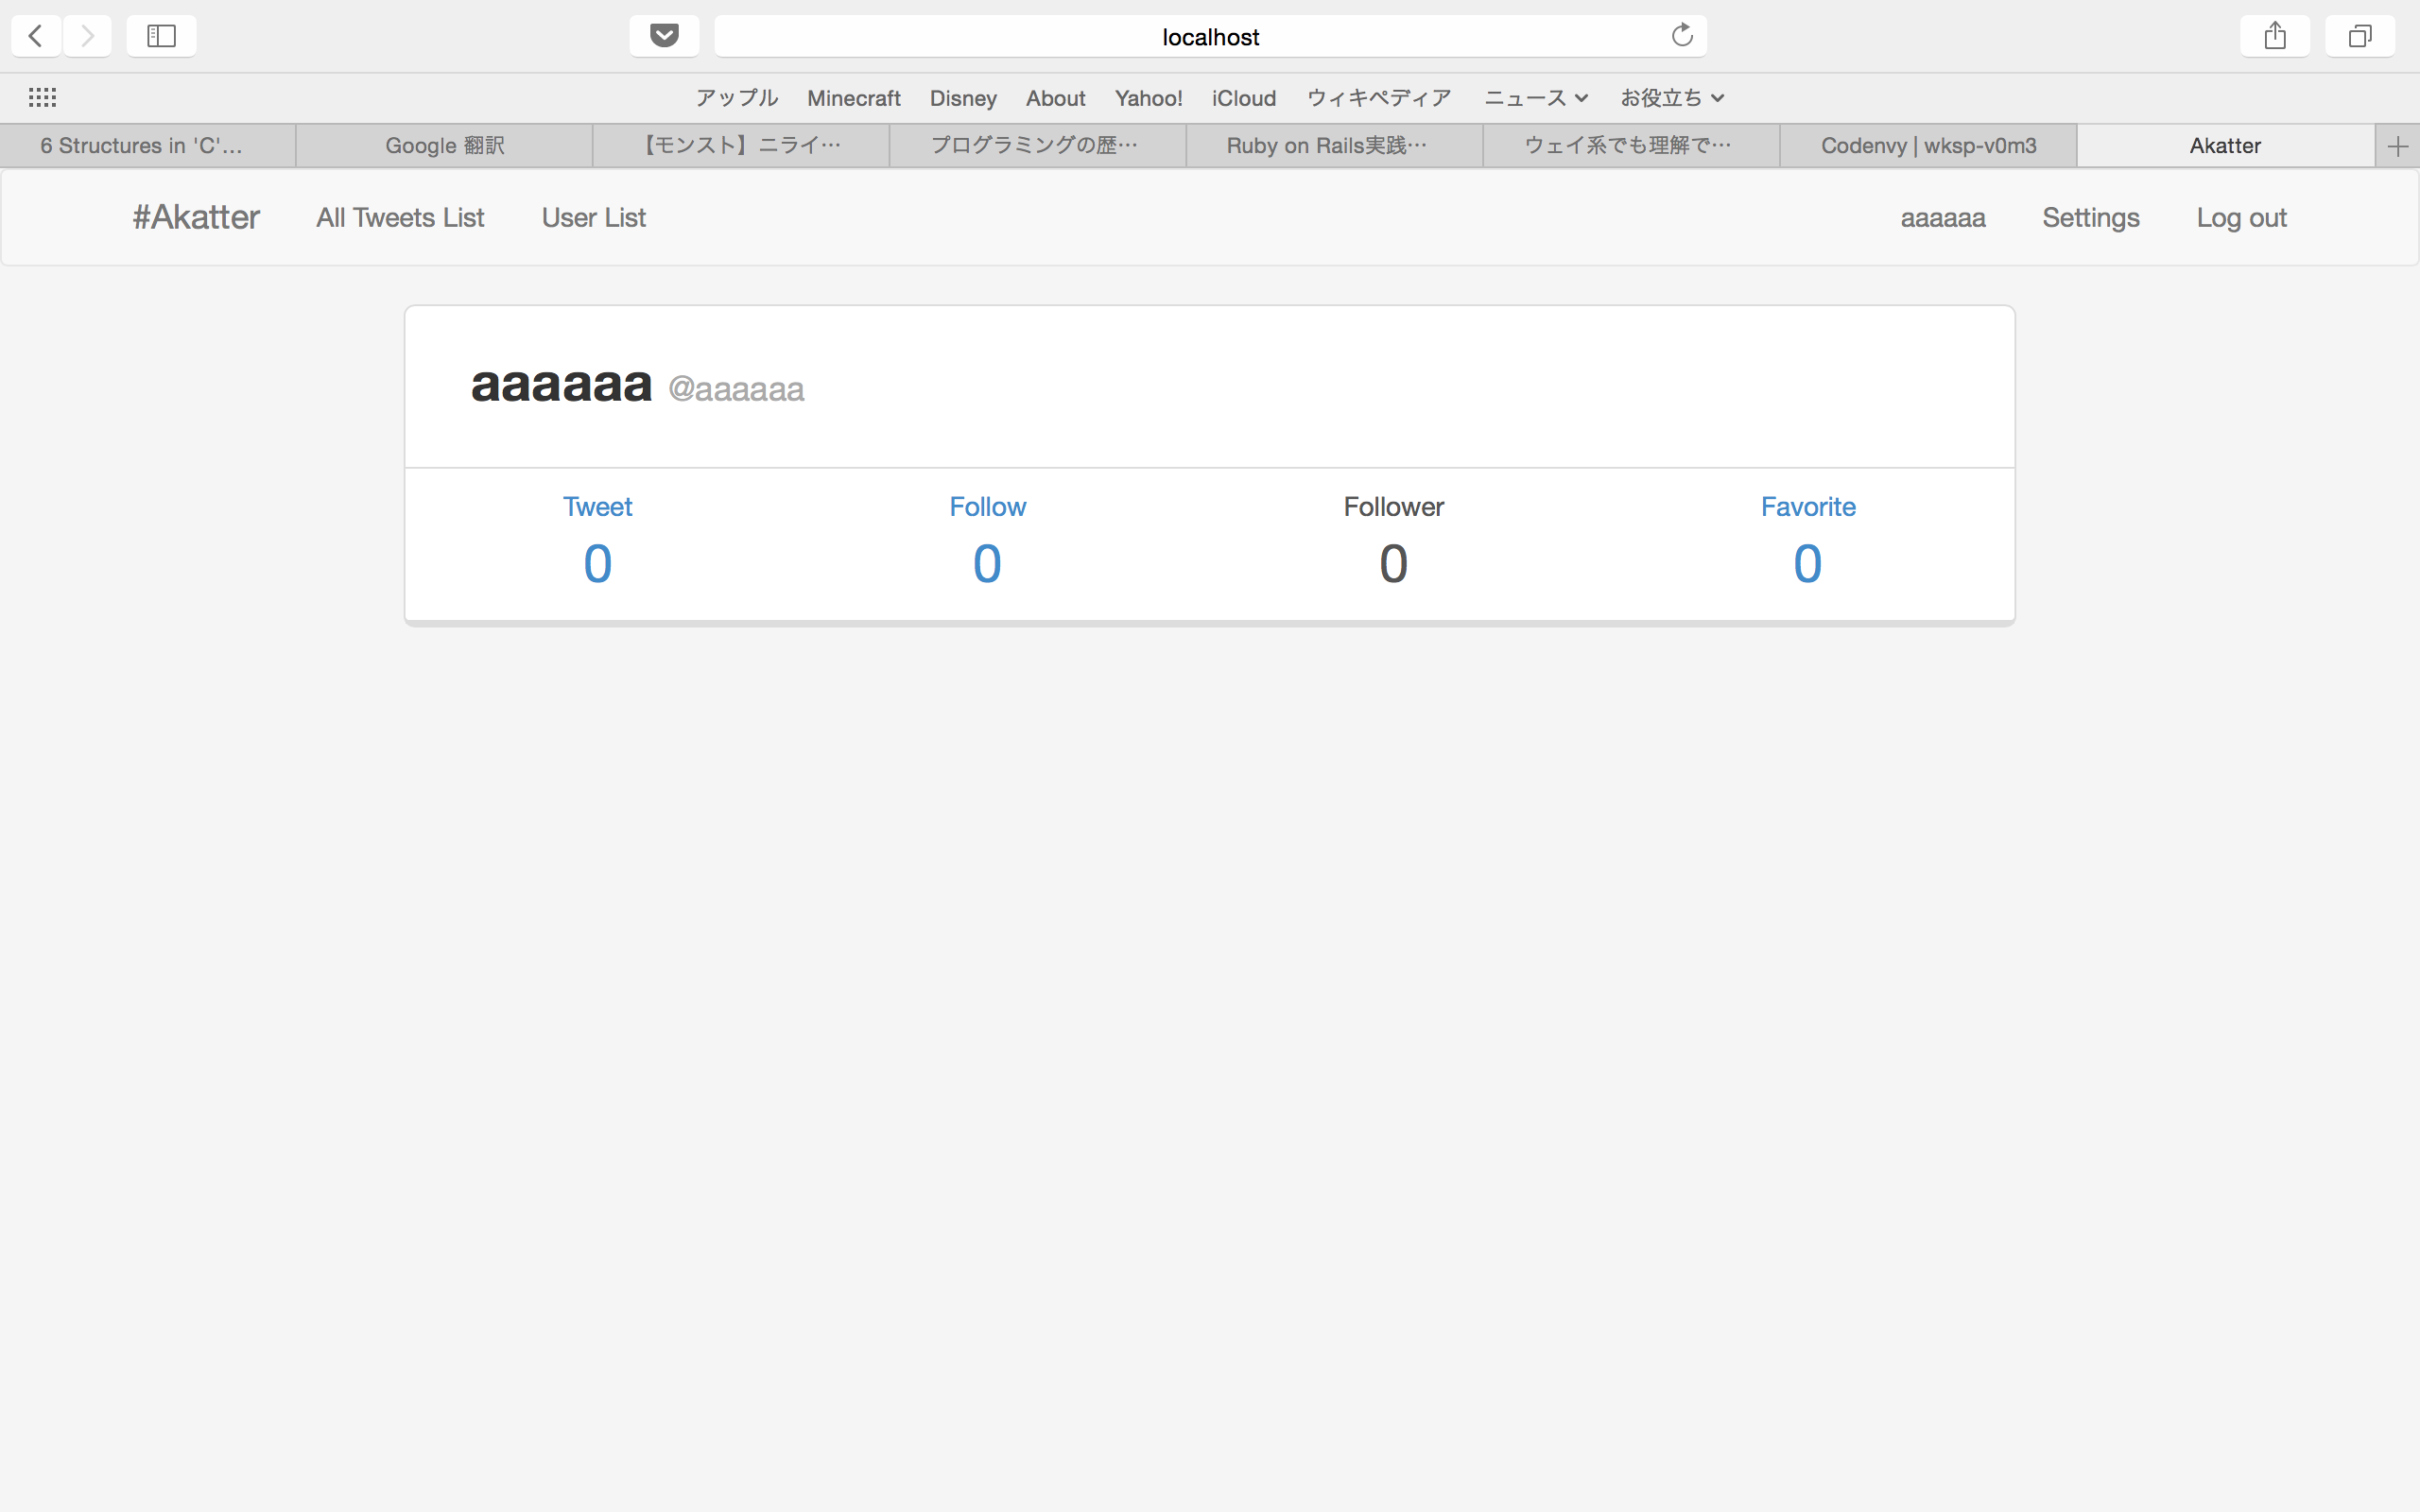
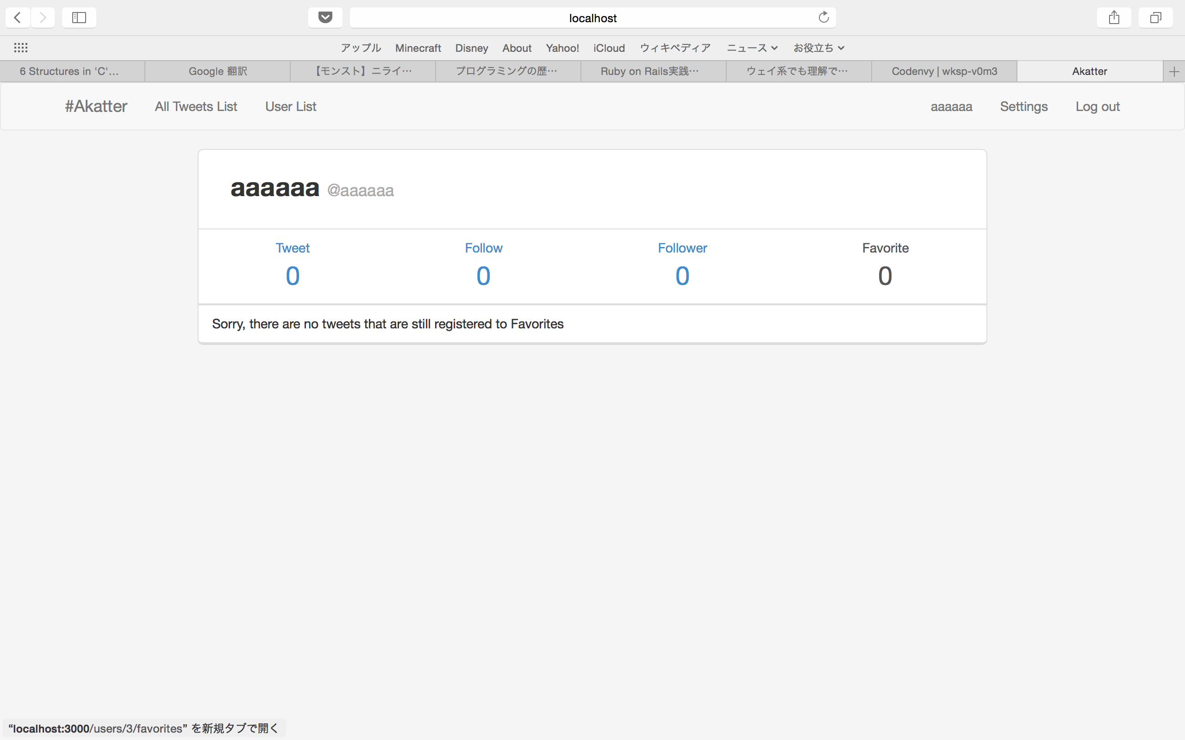
Profile
Follow List
Follower List
Favorite List

Slide 10
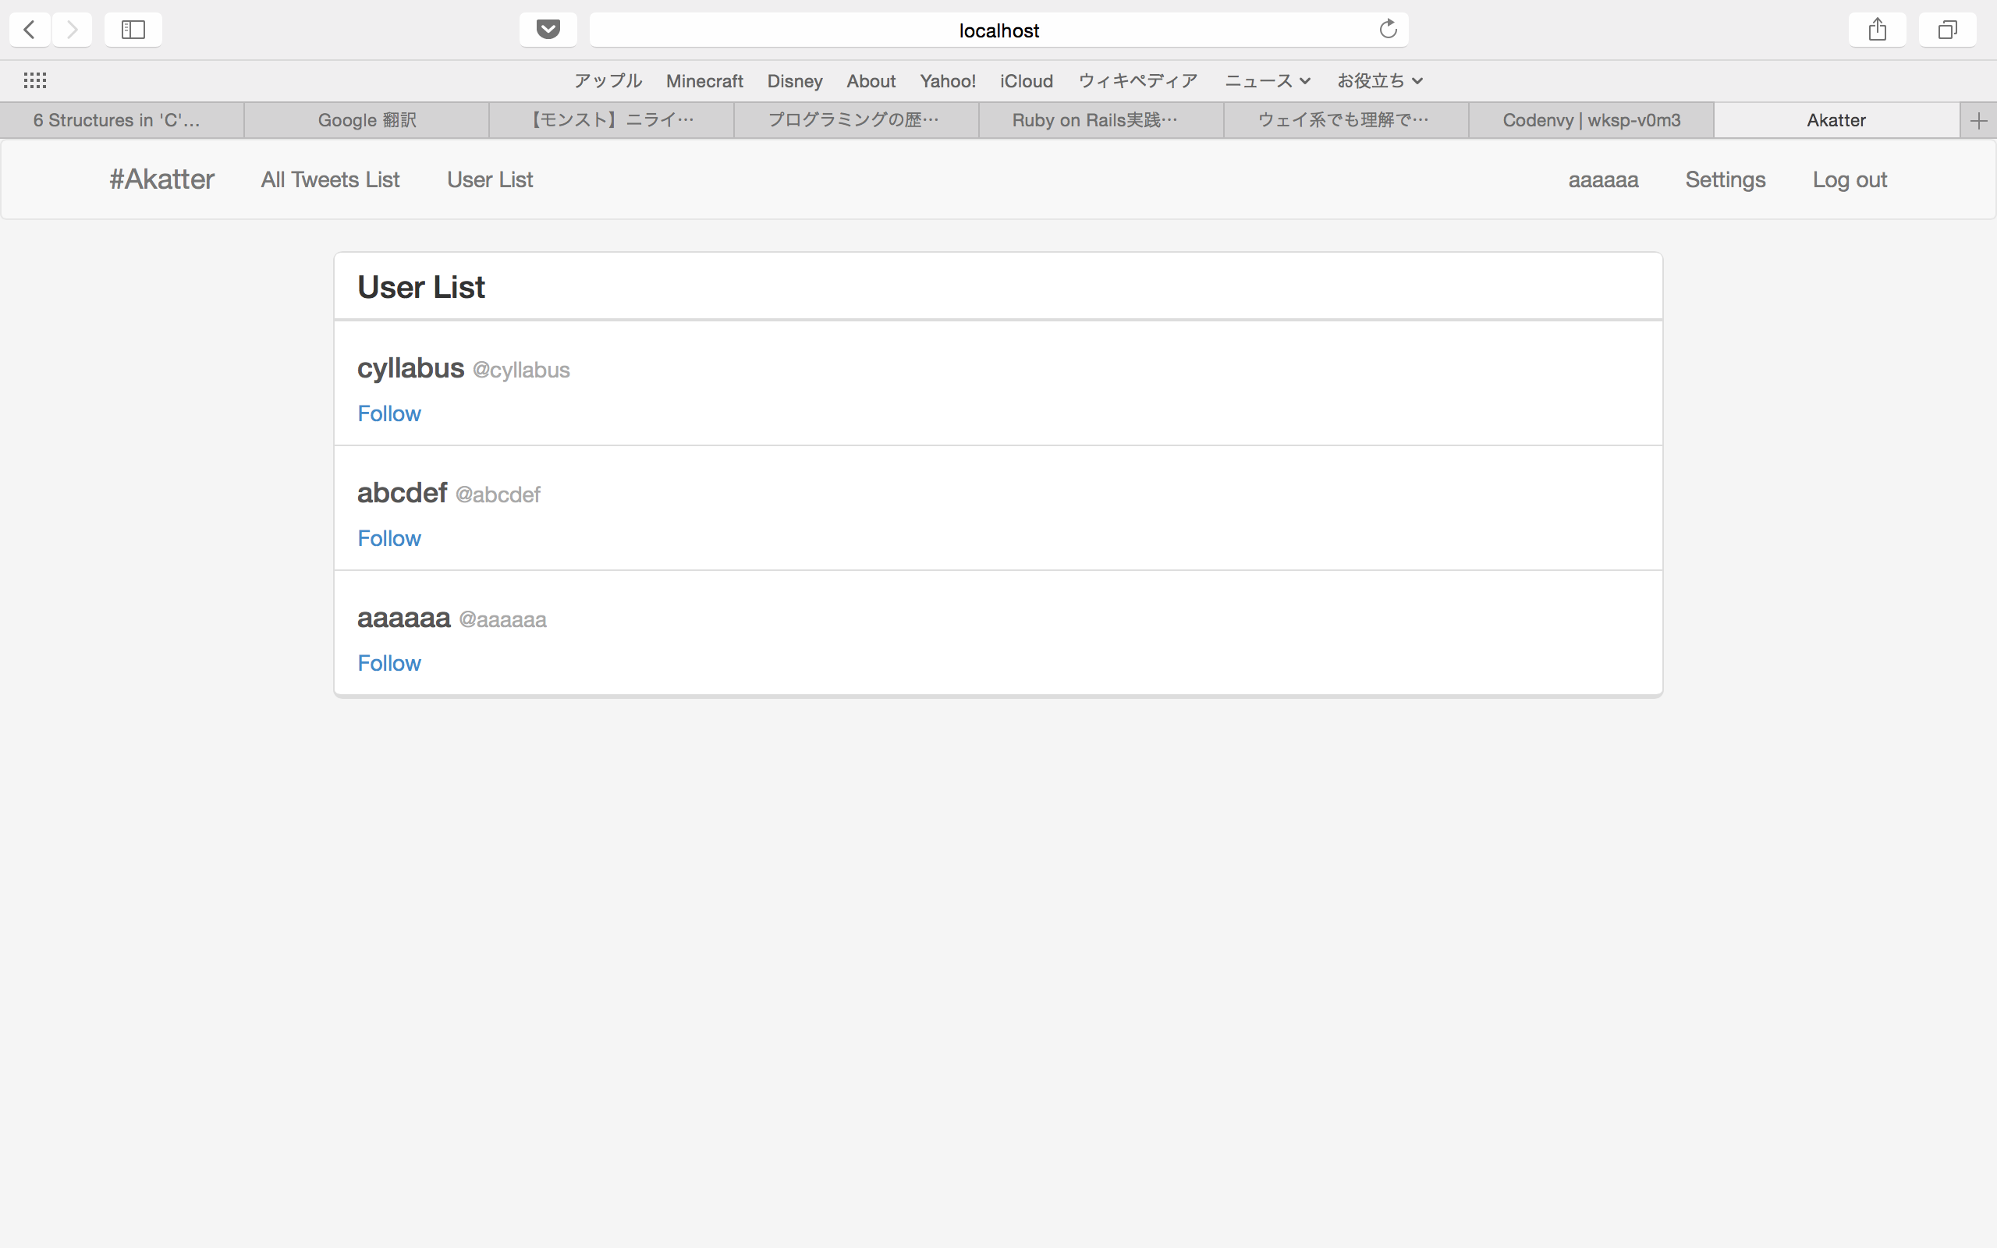
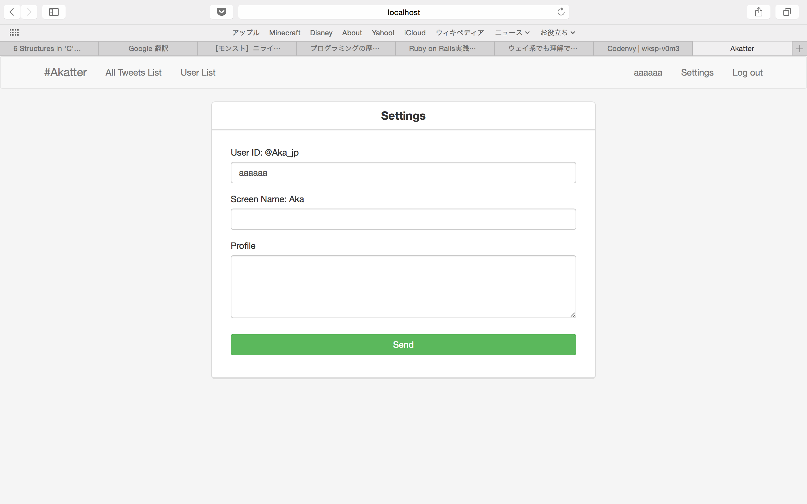
User List
Settings

Slide 11
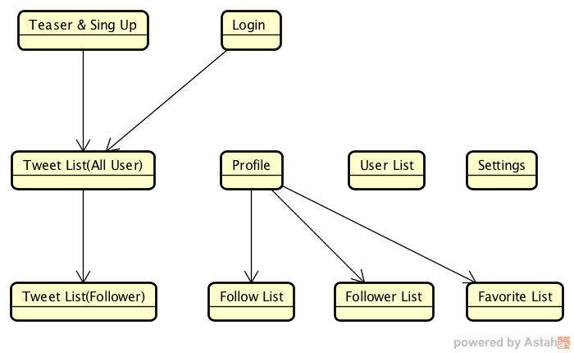
Screen Transition Diagram

